Slide 1




INTERNSHIP
Pravash Raj Upreti
3820 / 70
Tribhuvan University
Hetauda City College
Softweb developers

Slide 2
PURPOSE AND OBJECTIVE
Learning outside the boundaries of course curriculum
I like problems solving so this is the main reason behind choosing programming field
The main objective is to develop skill ,strong resume

Slide 3
Company overview
Established on 2072
Situated at Hetauda, Makawanpur
Work on software and web solution

Slide 4
PROJECT OVERVIEW
Share what you know
Online educational platform
Helps instructor and student to utilize leisure time
Instructor creates class and is location based
Class can be of two types , package class and recurring class
Student search city wise and use google map to locate and measure distance

Slide 5
PROJECT DURATION
Total 16 week and started from starch
1 week for planning and analysis
1 week for research of existing online platform
1 week for verifying all the requirements for from client
1 week for schema and database designing
5 week for complete UI component designing build and integration
4 week for backend API development
1 week for testing
1 week for deploying to server
1 week for report writing

Slide 6
S/W , TOOLS and technology USED
Phpmystrome IDE
Git and bit bucket
MySQL
Angular
Web socket
Laravel
linux

Slide 7
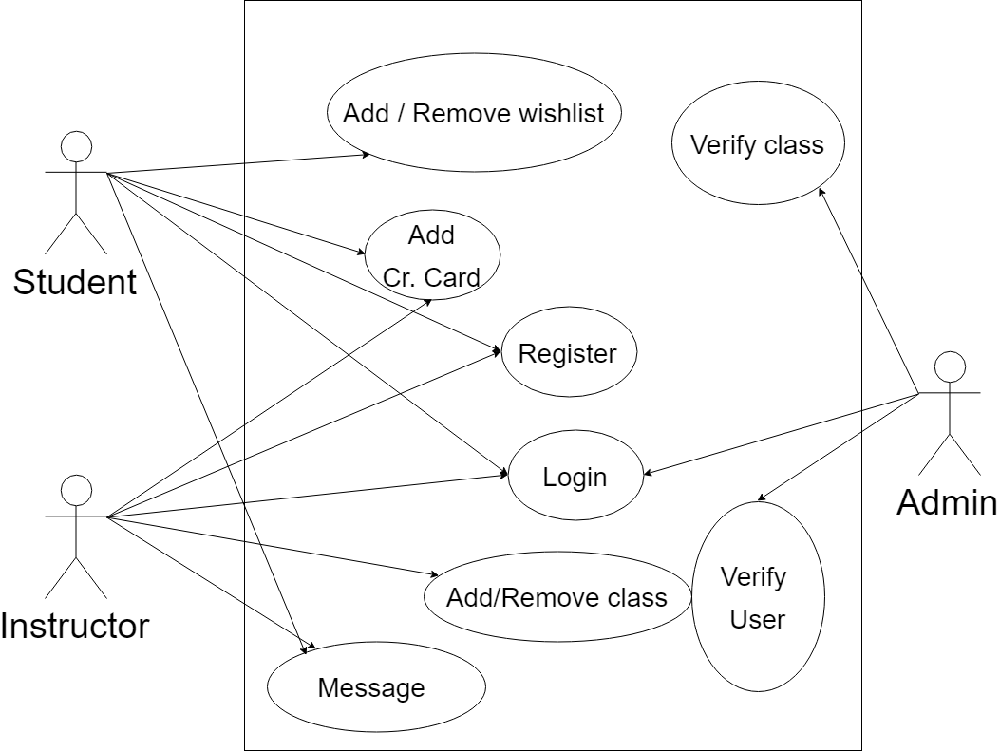
USE CASE DIAGRAM

Slide 8
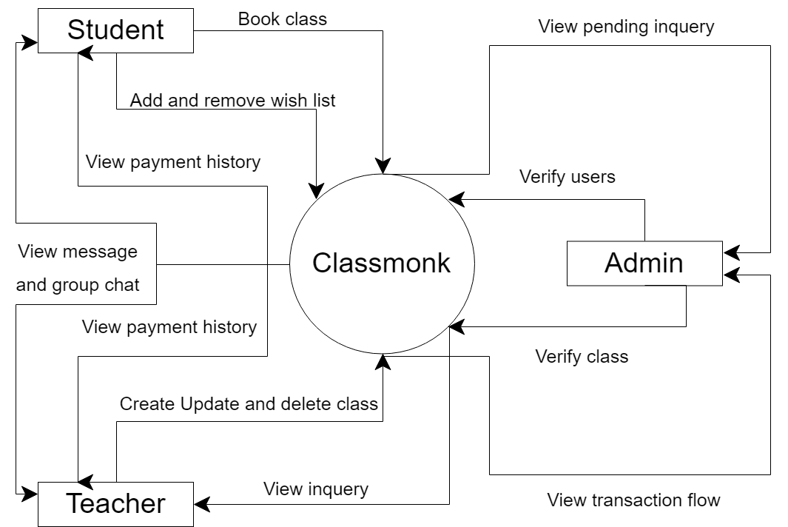
CONTEX-FLOW DIAGRAM

Slide 9
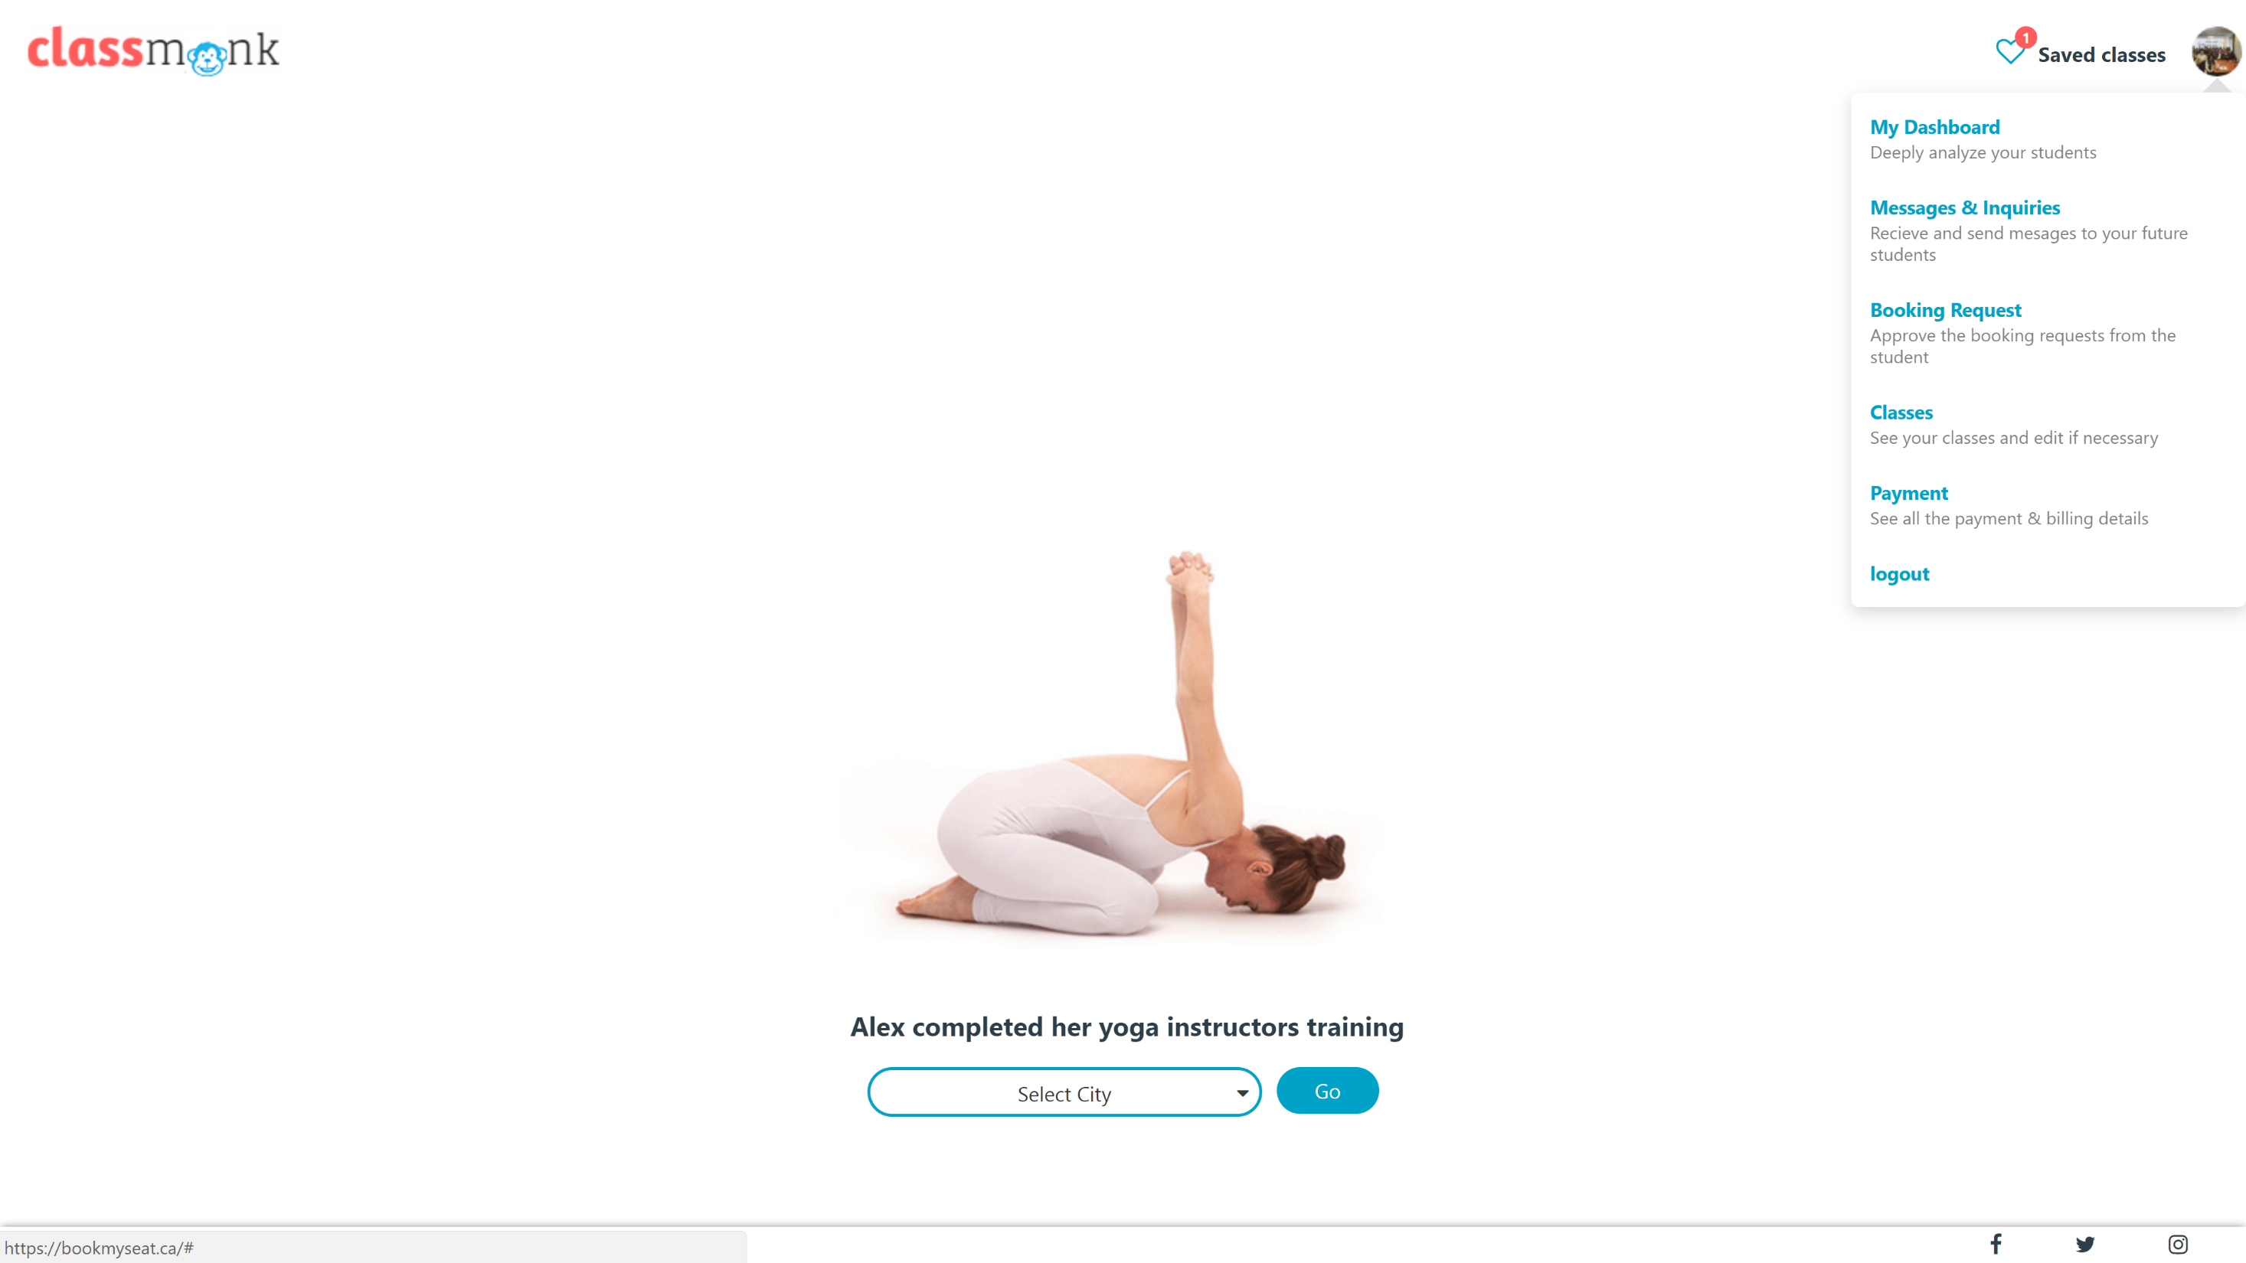

Slide 10
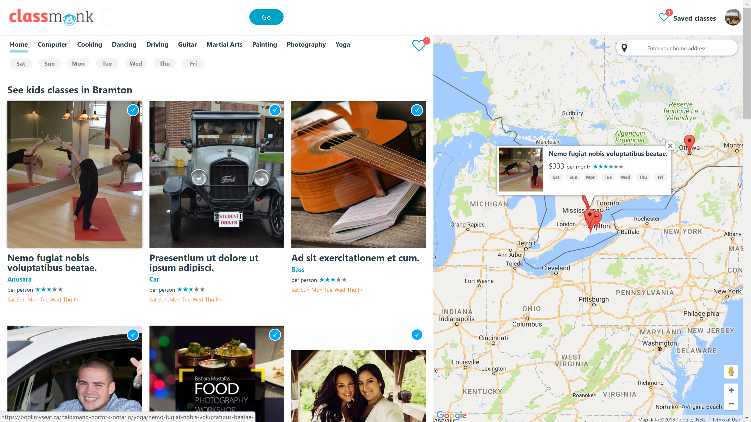

Slide 11
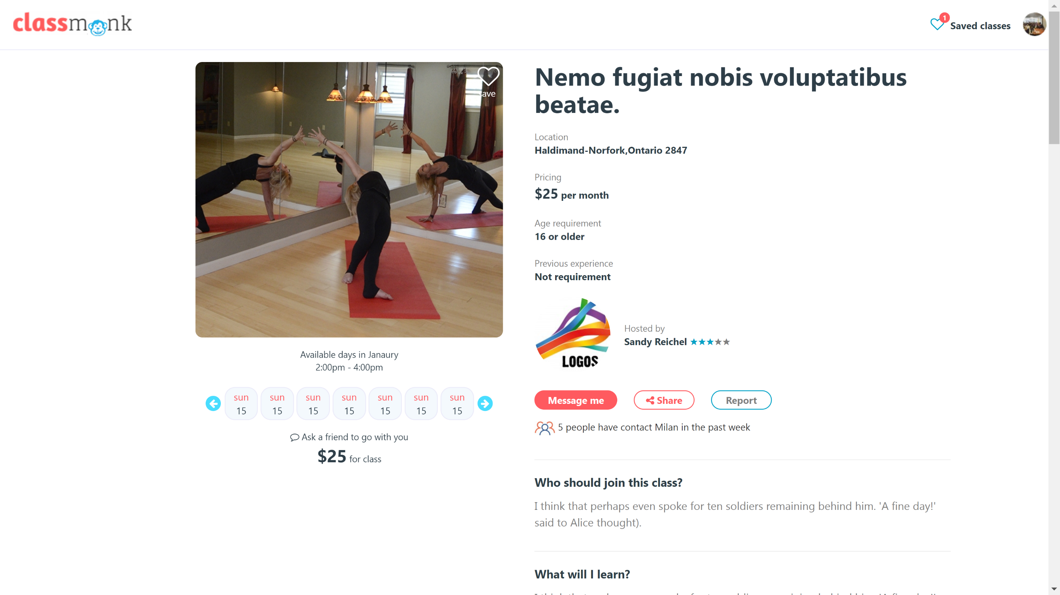

Slide 12
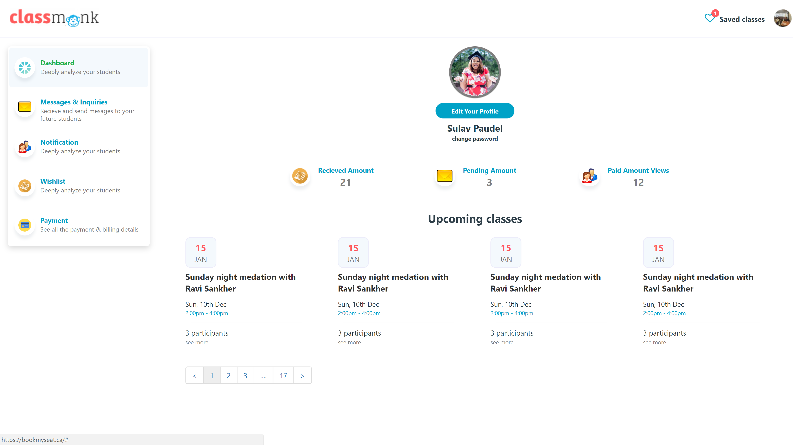

Slide 13
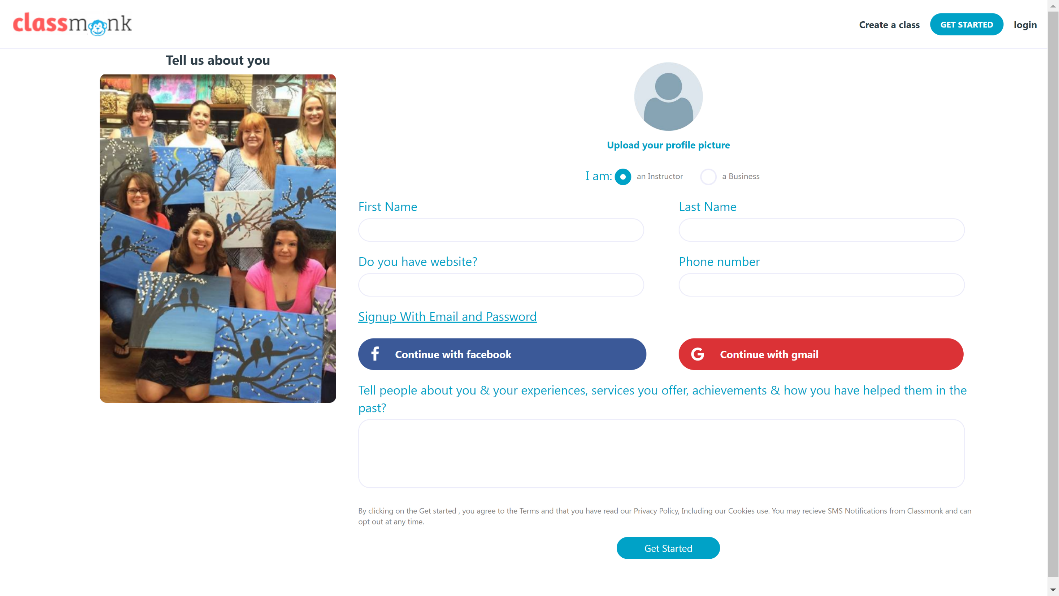

Slide 14
deployment
Installing software on Linux cloud
Maintaining current version
Dependency management
Monitoring server
And continuous integration

Slide 15
Recommendation and future enhasment
Load balancing server
Proxy server for better security
Multiple server with copy of app for maximizing the server uptime
Multiple database server for data replication and using master slave architecture
KYC details
Mobile app
Machine Learning

Slide 16
The End

